Slide 1
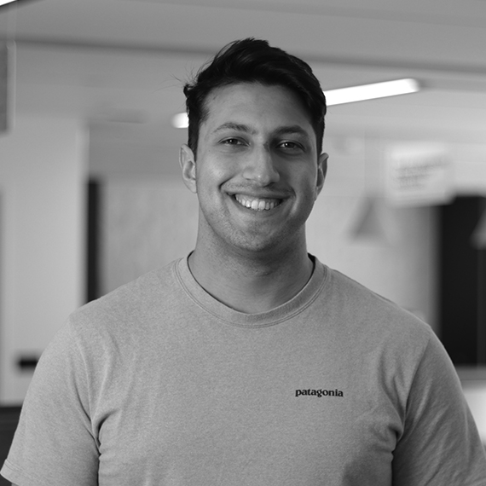
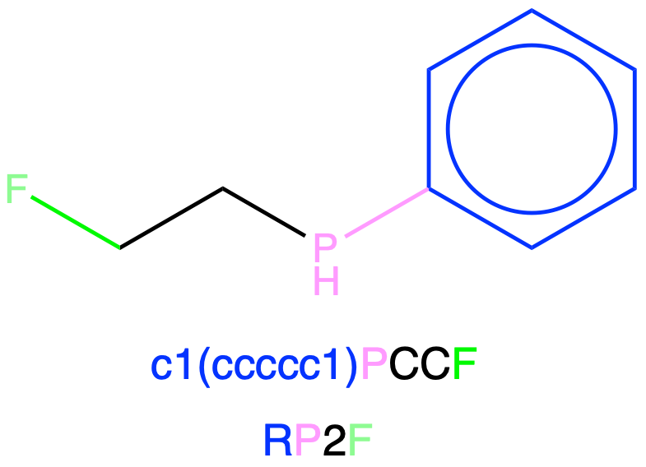
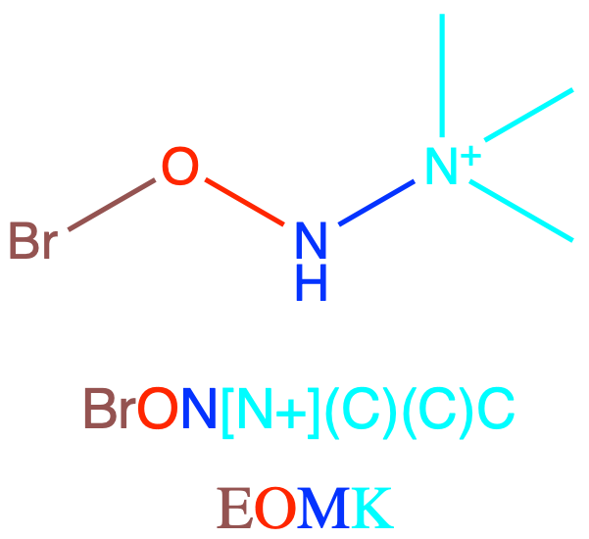
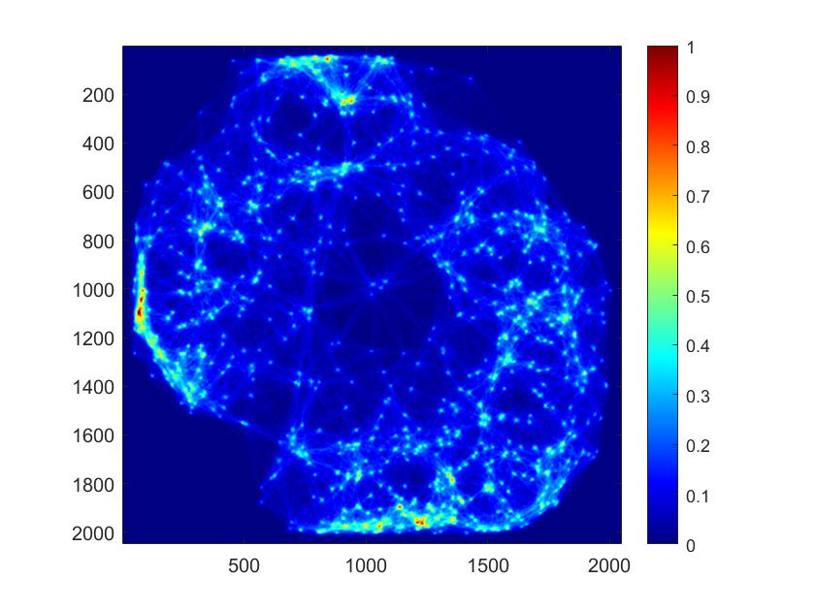
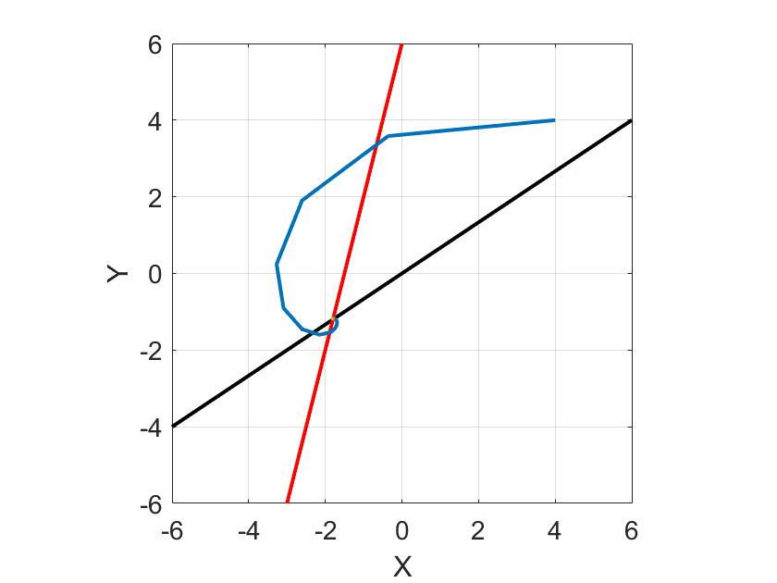
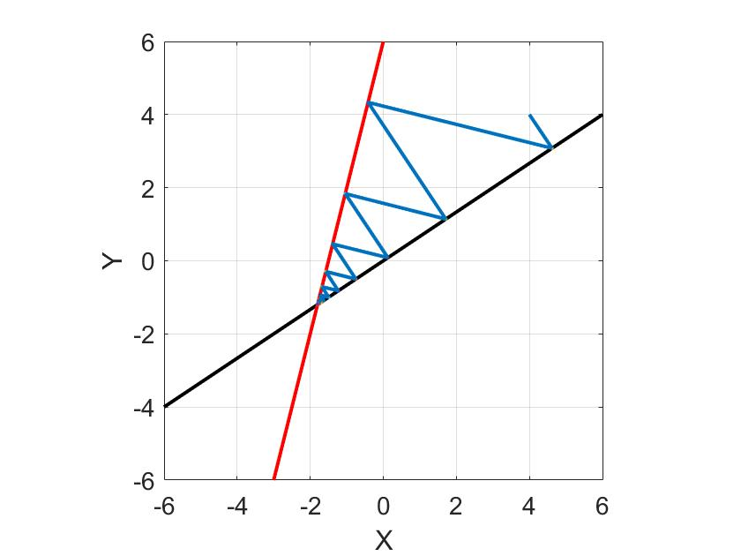
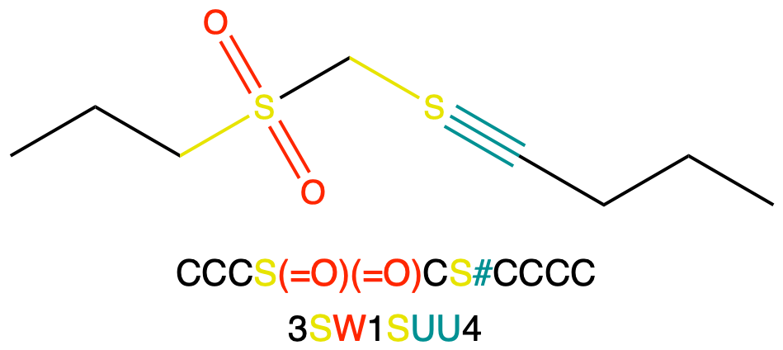
Michael Blakey
My Current Research - Method Development
WLN Notation - Reading/Writing plus Fast Algorithms
Ptychography - Optimisation Algorithm Development
Jeremy Frey
Michael Blakey
The Frey Research Group
University of Southampton

Slide 2
Zombie Cheminformatics
- Wisswesser Line Notation
Taken the reader from 73% to 97% chemical space coverage
This involved hardcoding the WLN rules into the OpenBabel C++ Library
These rules are known and was an implementation challenge
CCCCCCC(CC)(Br)CCPc1ccccc1
6X2&E2PR
WLN writer has 97% read success

Slide 3
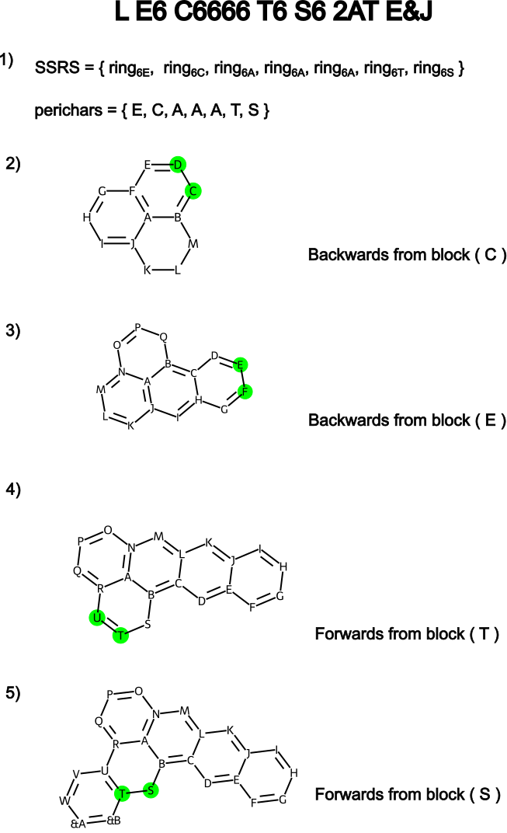
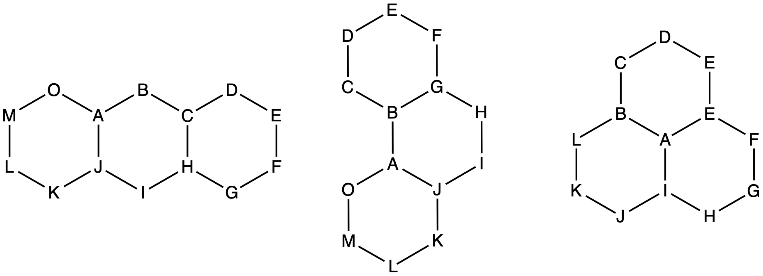
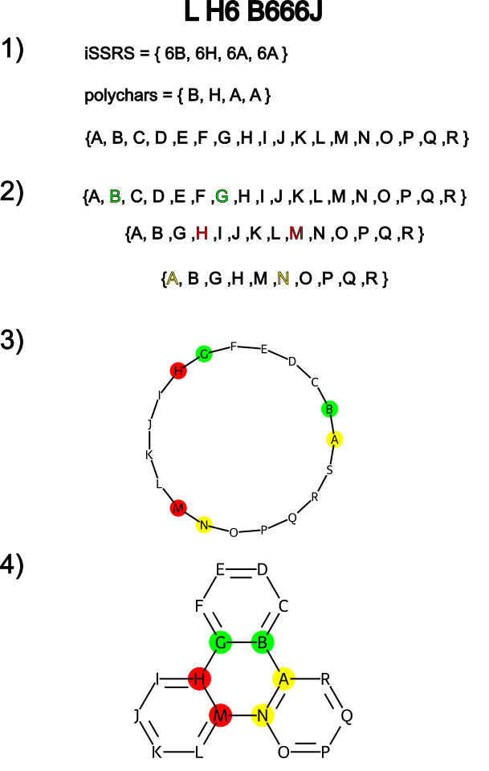
WLN - Molecular Salesman
Complex rings were solved with a backtracking algorithm used for the travelling salesman problem
Hard problems… are very hard

Slide 4
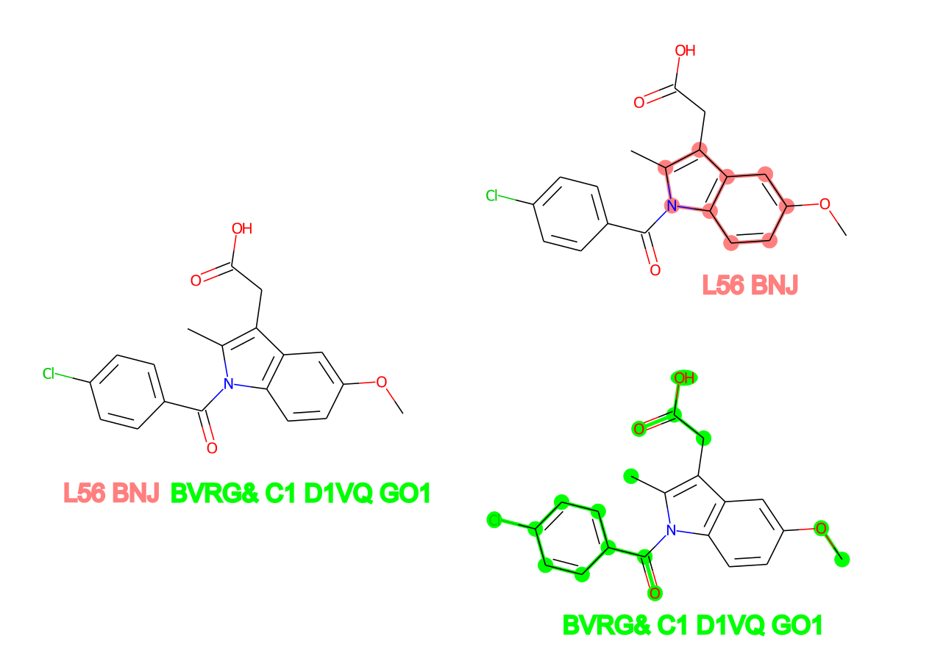
Core Assignment & Substructure Searching
Locant Path lets us define core and R- groups for both read and write

Slide 5
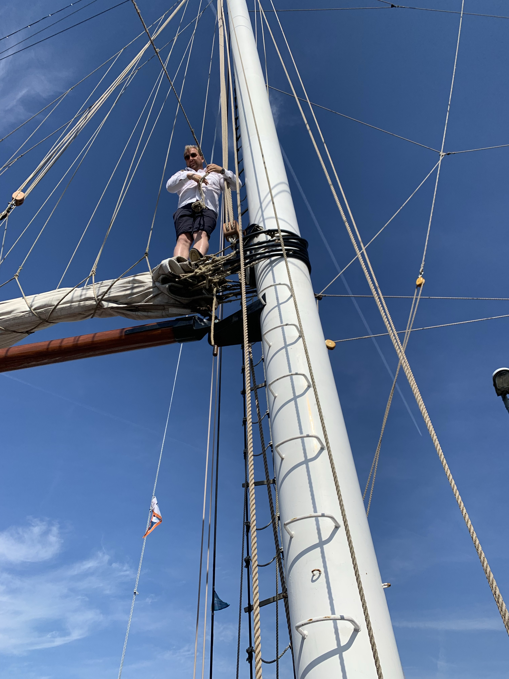
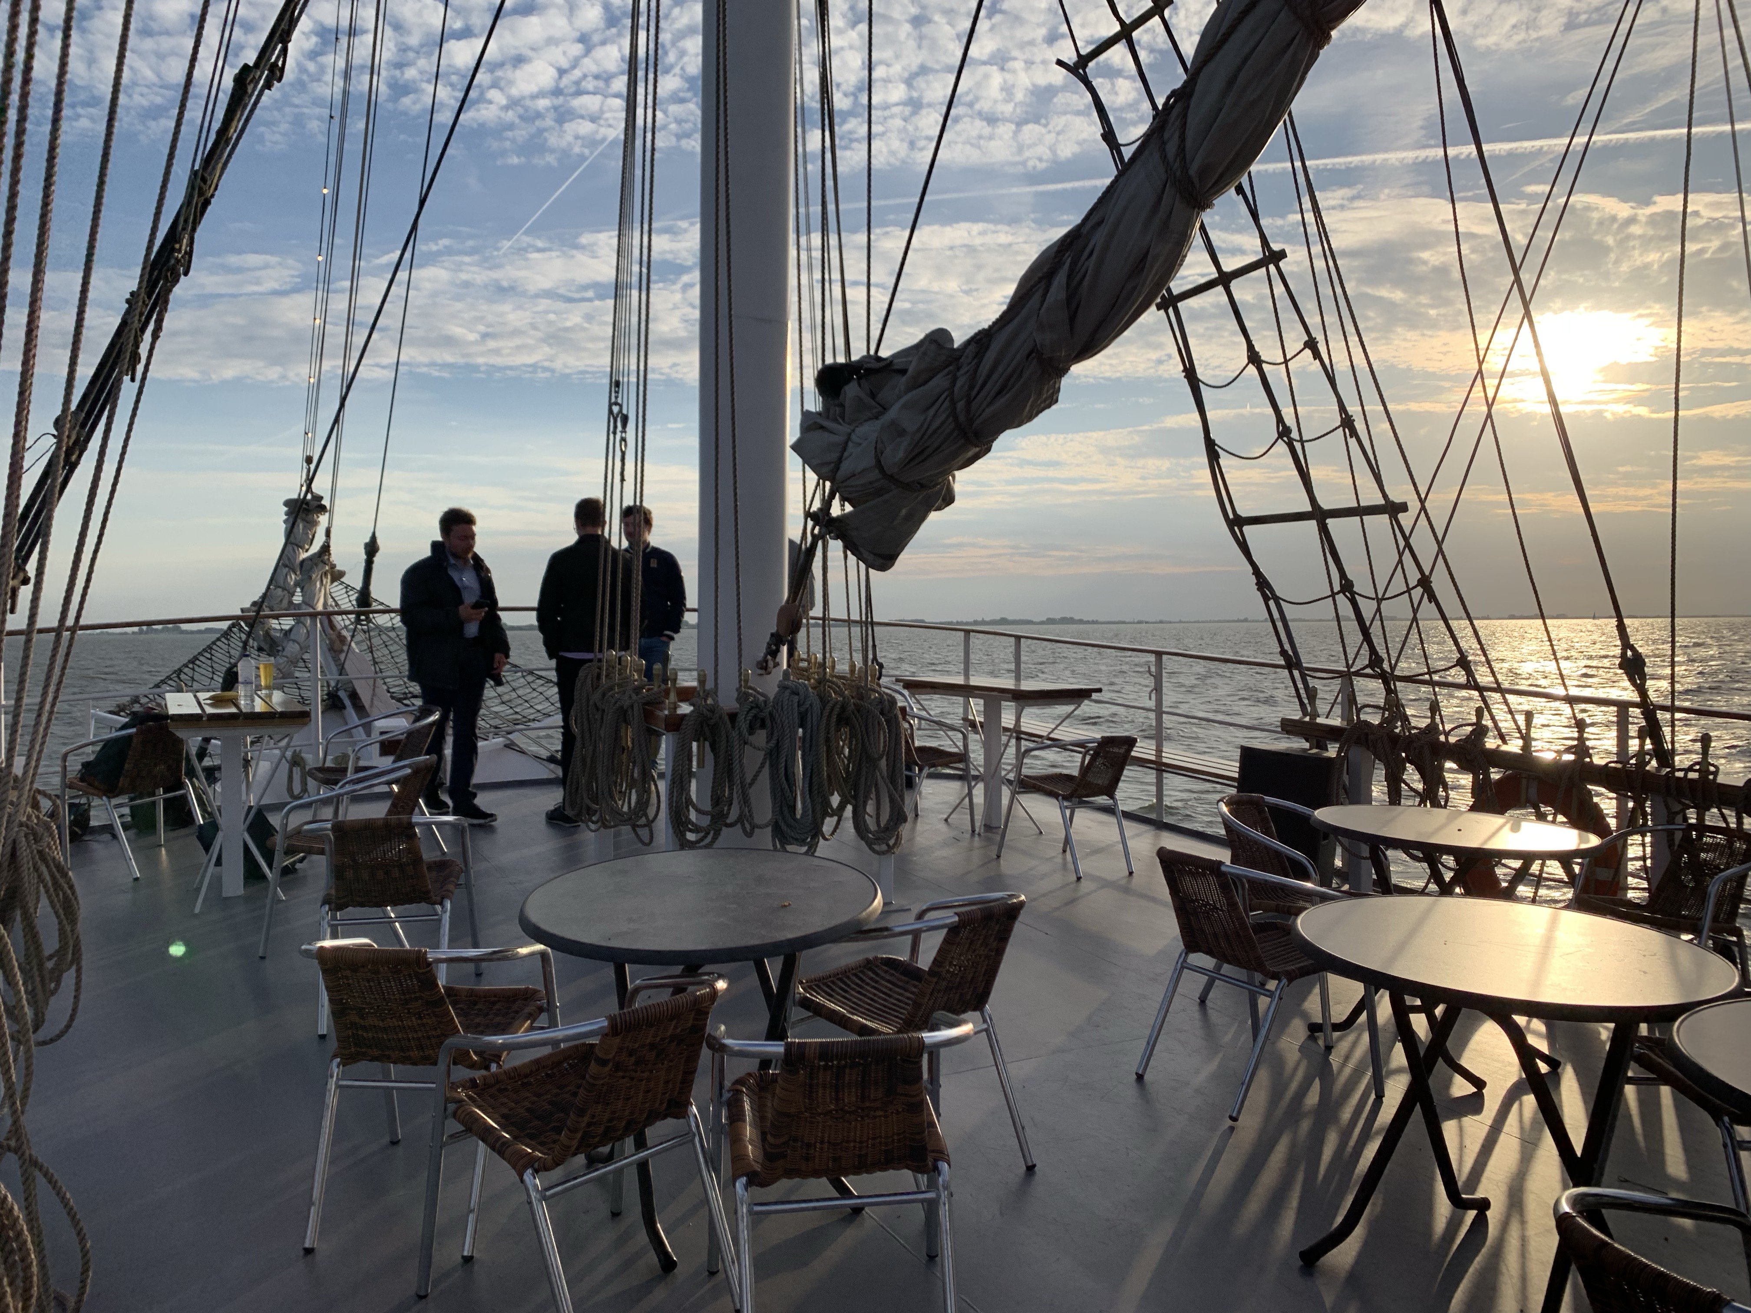
ICCS Conference
Yachting…

Slide 6
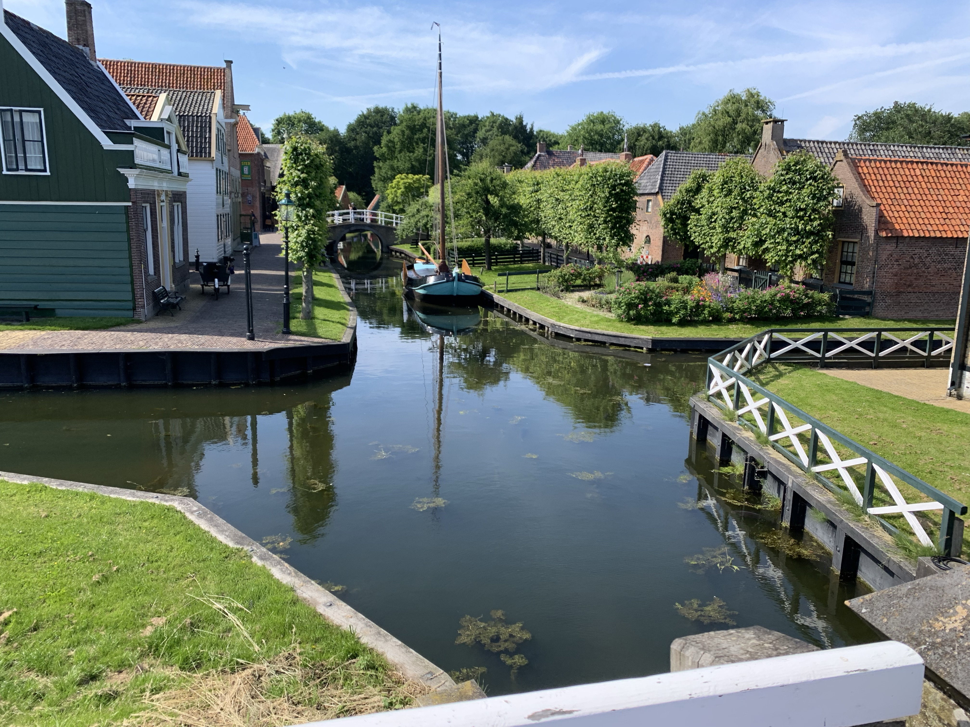
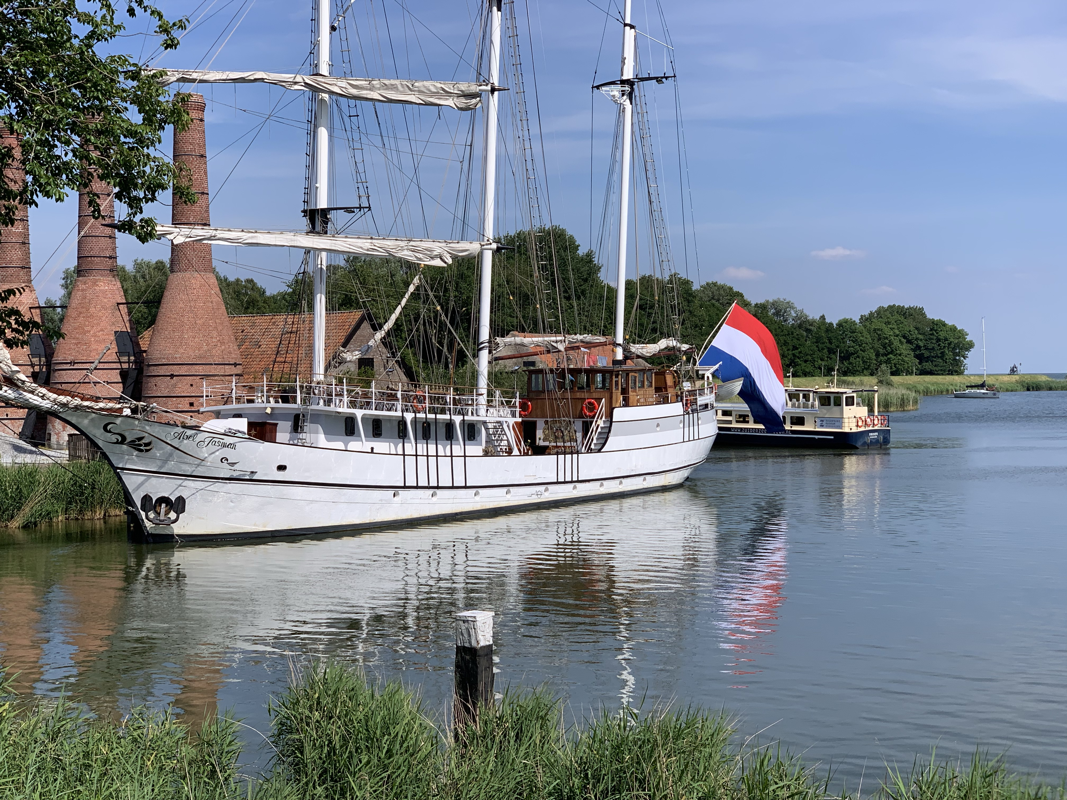
ICCS Conference
Walking…

Slide 7
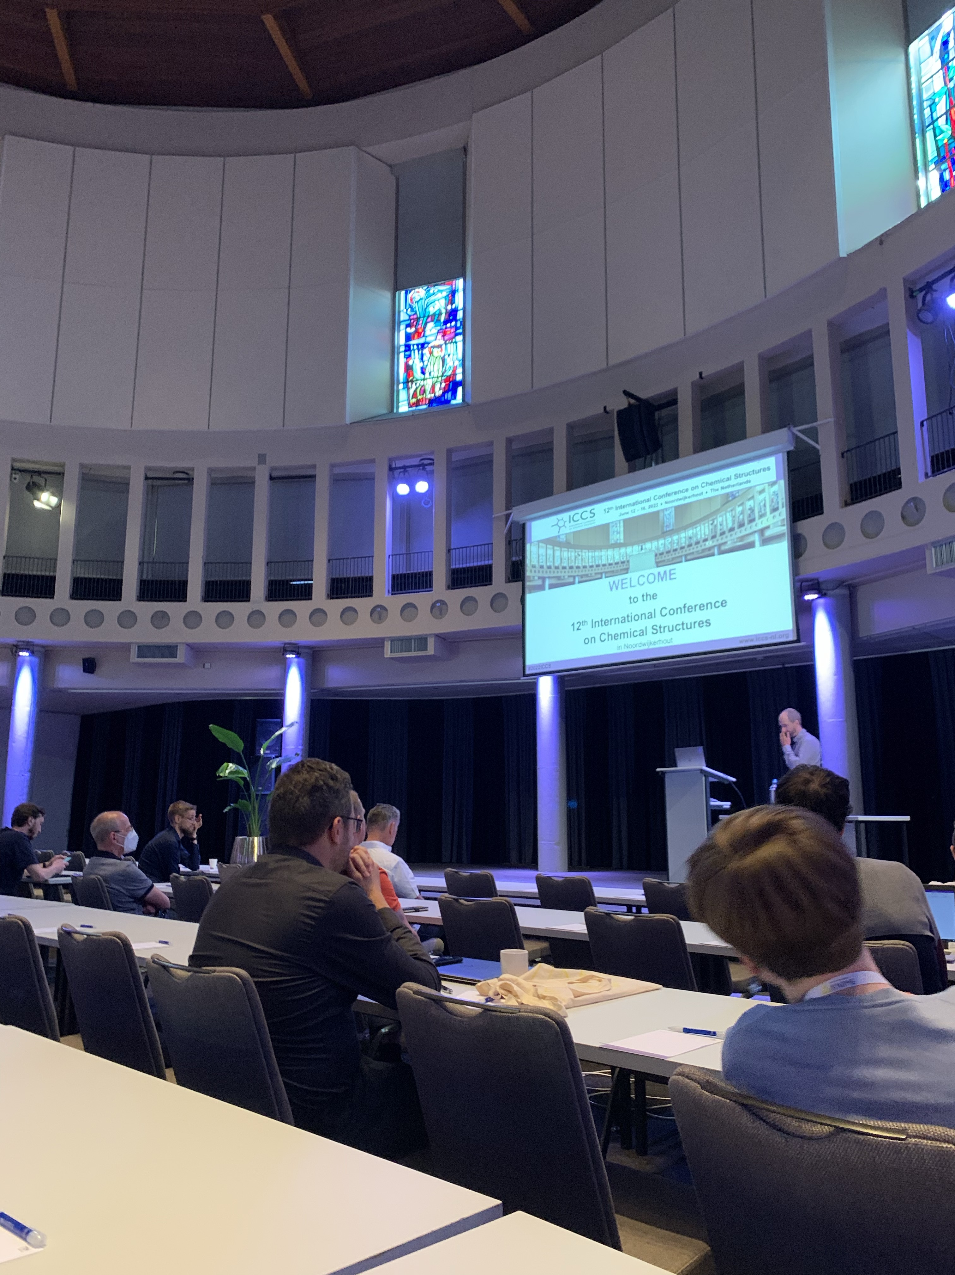
ICCS Conference
Tiny bit of working… *
* Networthing

Slide 8
Placement - Off we go…
6 months in Cambridge learning
lots and lots and lots and lots of stuff

Slide 9
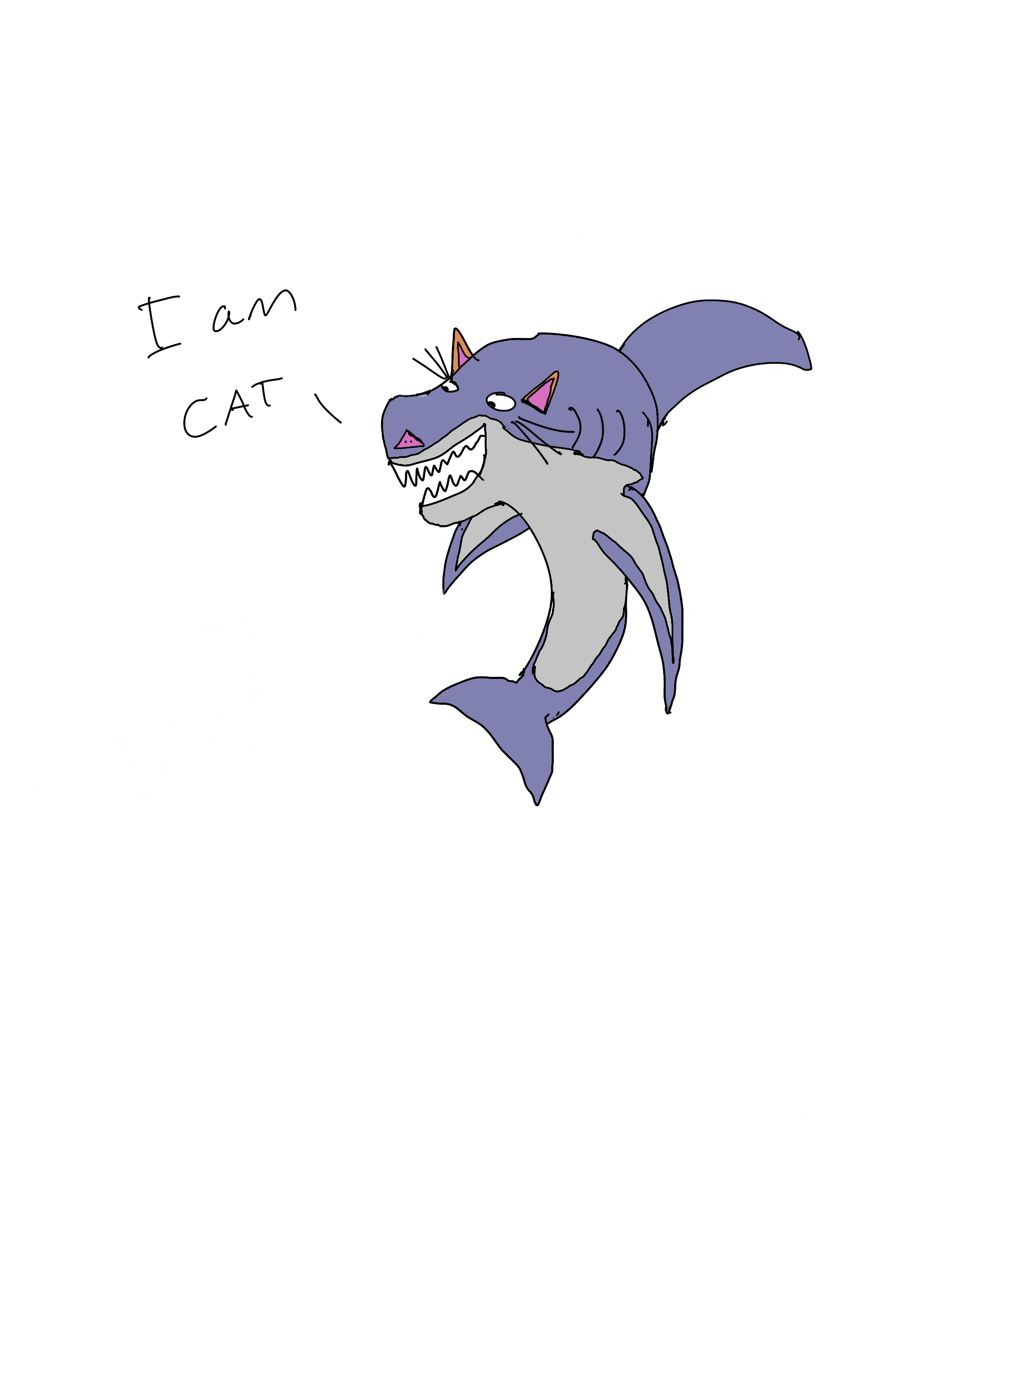
Thanks for Listening!
Vote Sharkcat for 2023

